Slide 1
Bray Team Week 8 Update
Avery Haynes, Locke Lehmann, Travis Carlson, Cody Sims, Zachary Walker, Michael Hager
3/18/2024

Slide 2
Weekly Deliverables
Tasks | Lead | Percentage Done | Notes
Begin potentiometer validation testing | Avery/Locke | 80% | Just need to test in the valve
Build frame for valve and actuator and motor mount | Cody/Travis | 80% | Motor mounted just need to complete valve mount
Implement sensors into system | Zack | 50% | Successfully have drilled into stop bolts.
Wire sensors into DAQ and computer | Michael | 100% | Completed.
Test Hall effect sensor | Locke/Travis | 25% | Made design, received sensor, must print test rig using new circuit board.

Slide 3
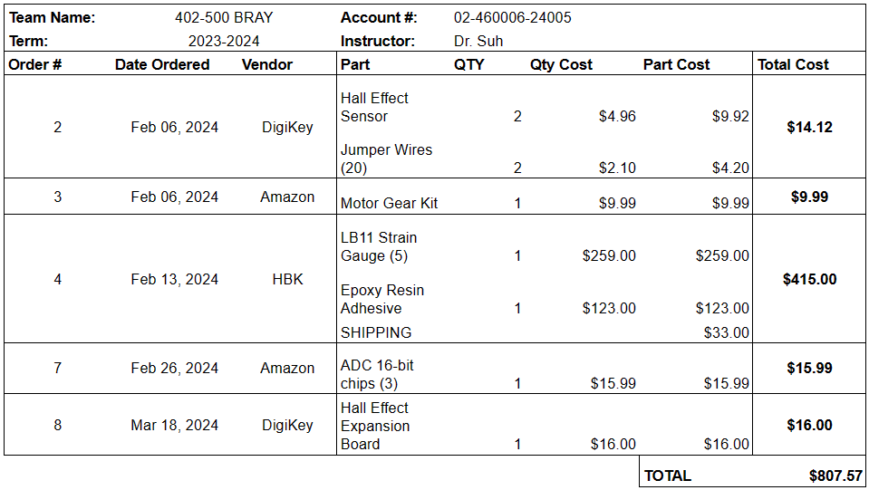
Purchasing Updates
Recently ordered Hall Effect Expansion Board ($16)
Will purchase materials for building testing rigs from Home Depot
Budget Update: $807.57 spent (out of $3,803 approved)
Notes:
Done - Avery 2/18

Slide 4
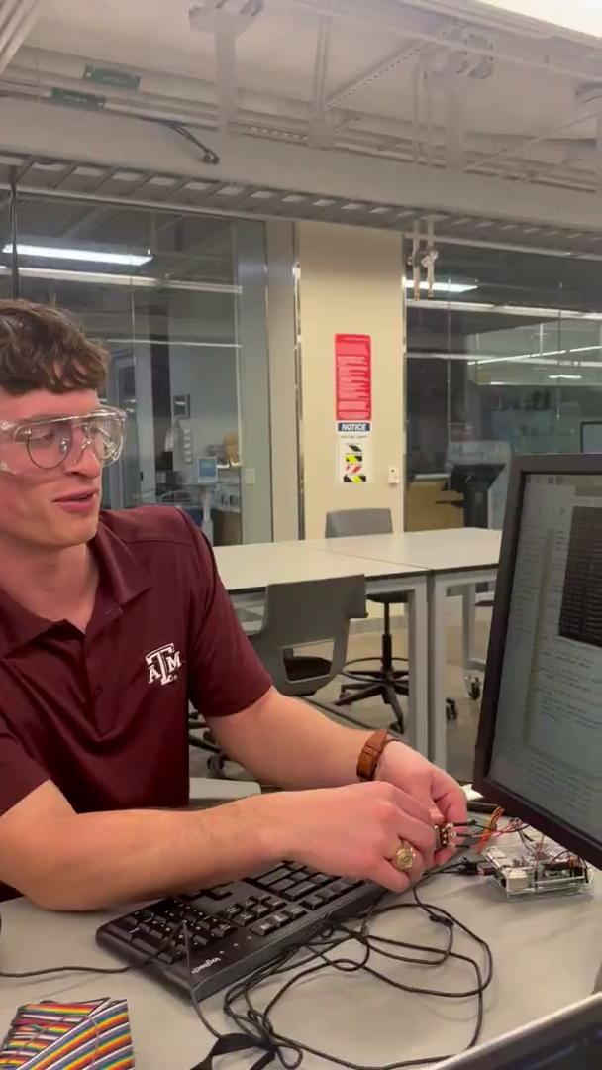
Potentiometer
ADC Chips soldered and connected to the Raspberry Pi
Can now read Potentiometer to an exact degree of rotation instead of just analog

Slide 5
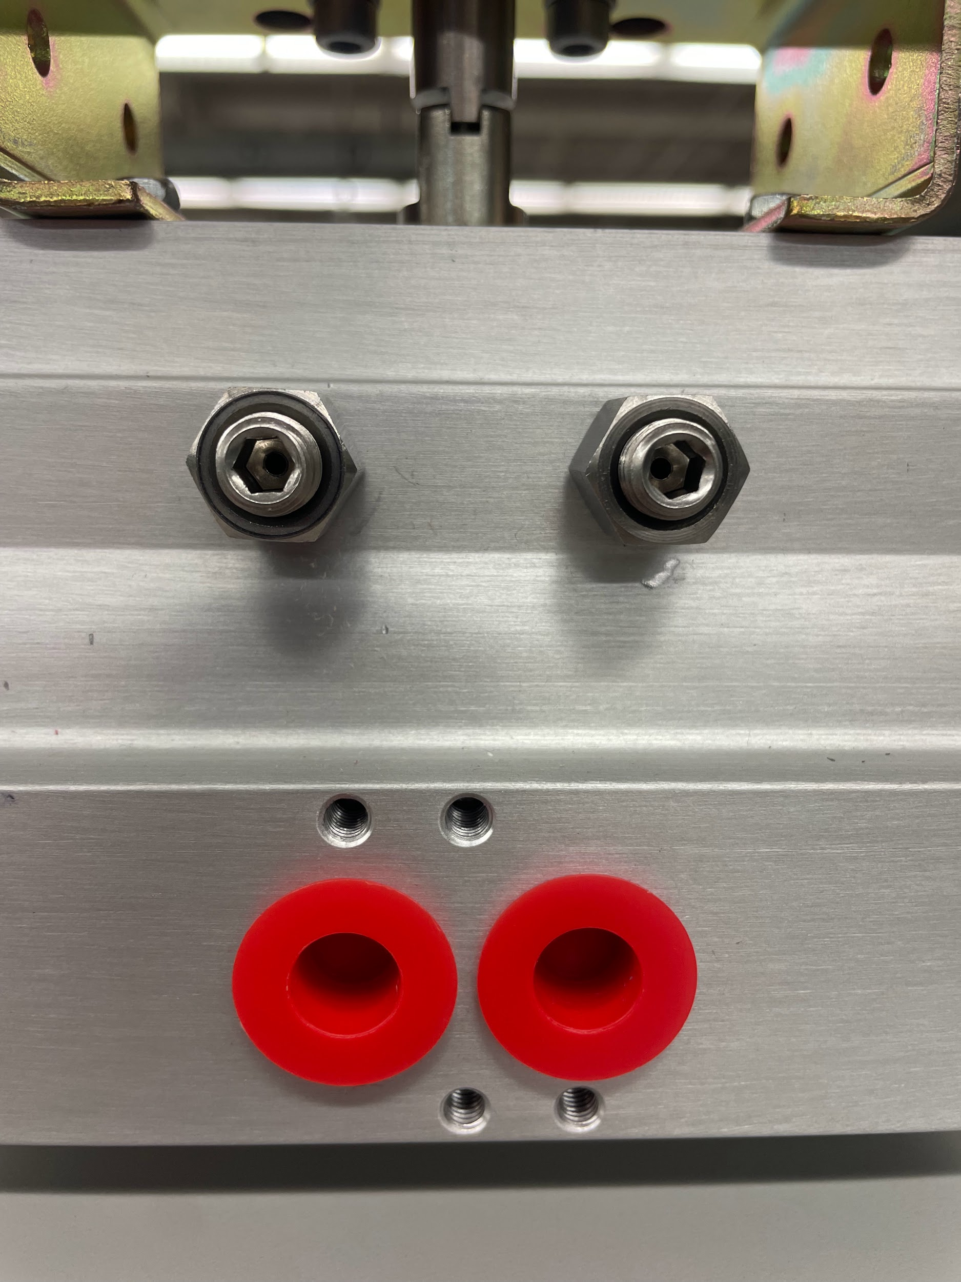
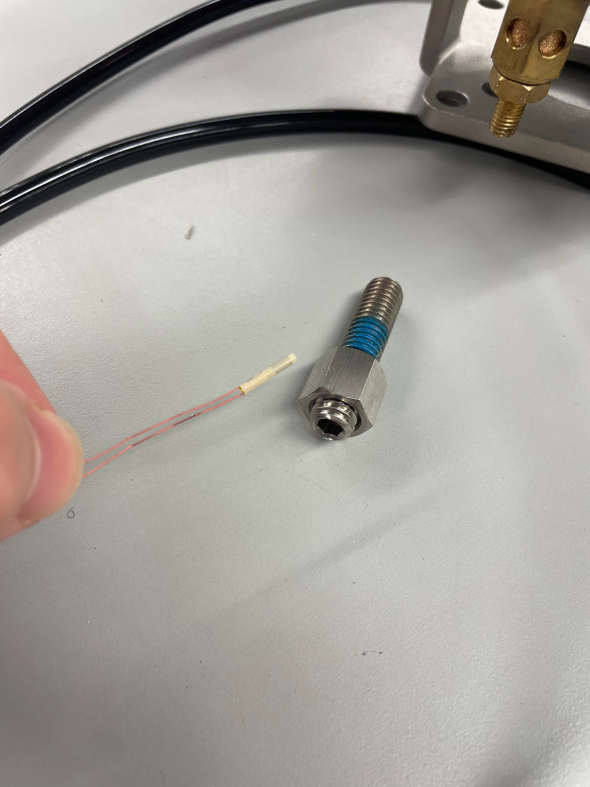
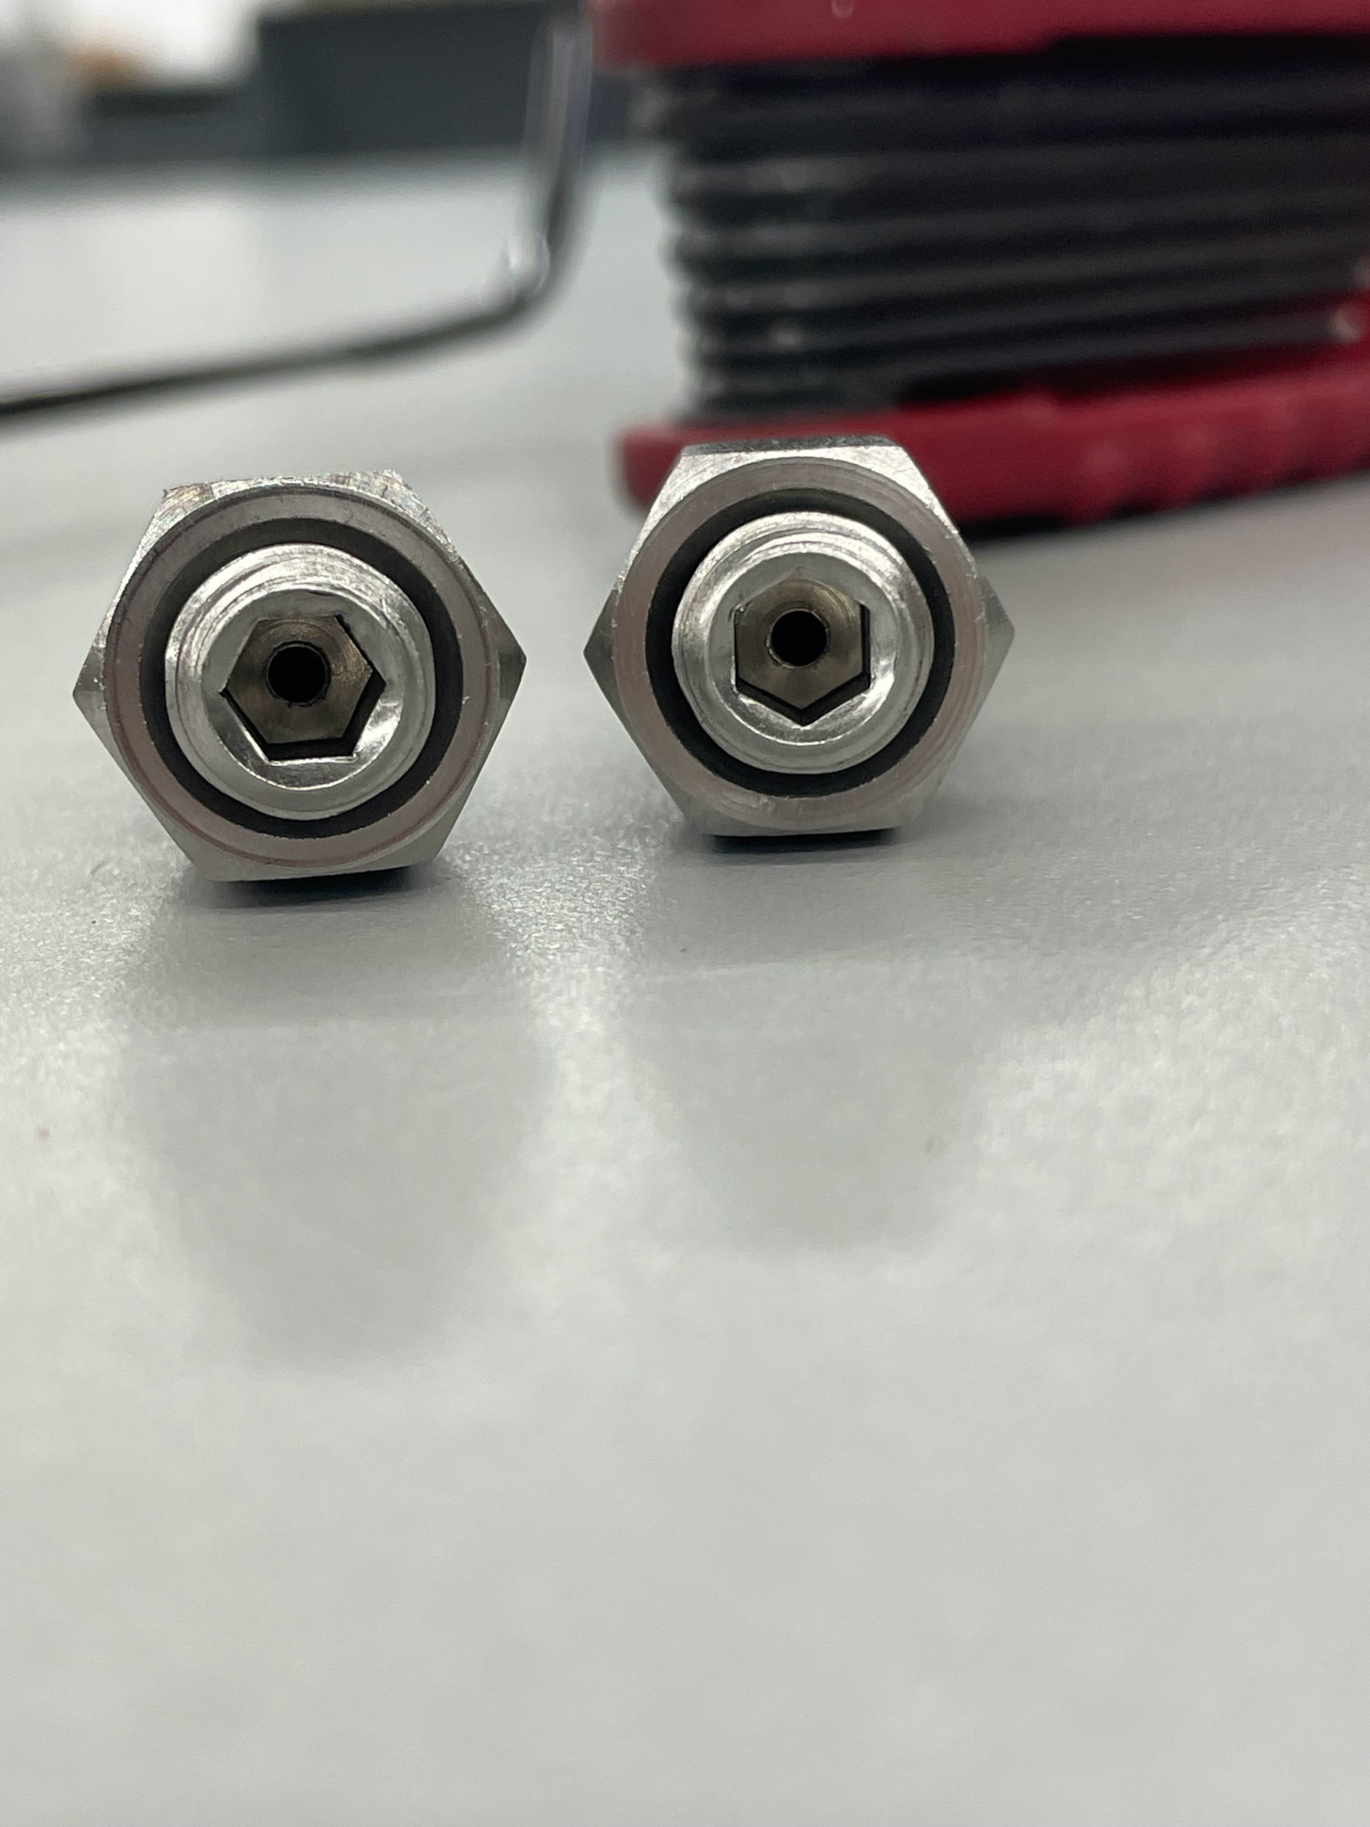
Strain Gauges
Cylindrical Strain gauges from HBK arrived
With some guidance from FEDC staff made nice drills
Next step - epoxy sensors into bolts

Slide 6
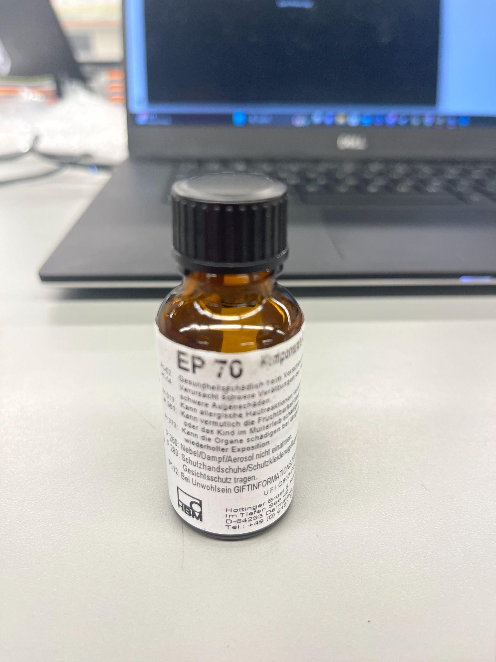
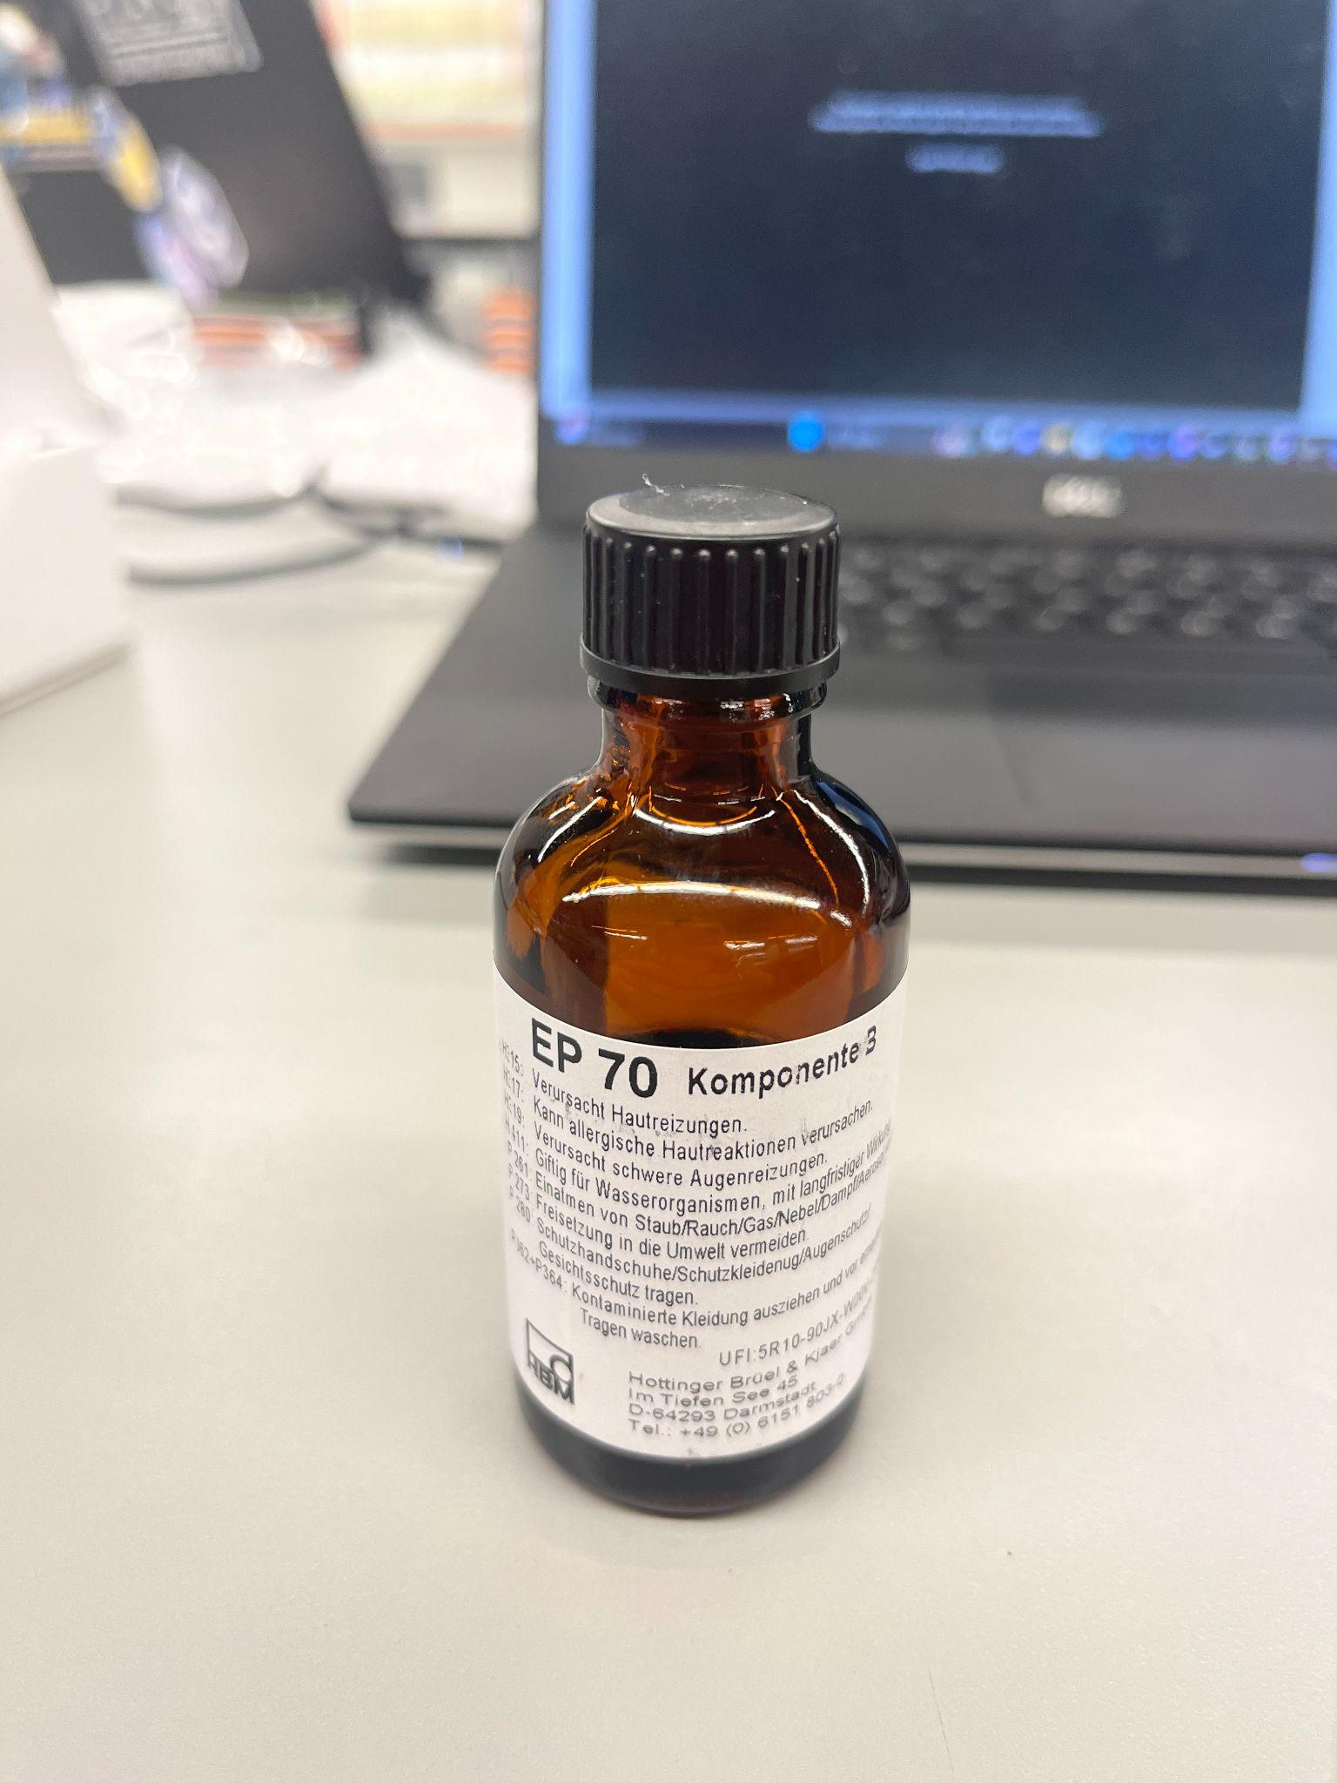
Adhesives
EP 70 Comp A&B
Registered with the FEDC and is in the chemical cabinet, must have proper PPE to use
Looking to use this week to install strain gauges into stop bolts

Slide 7
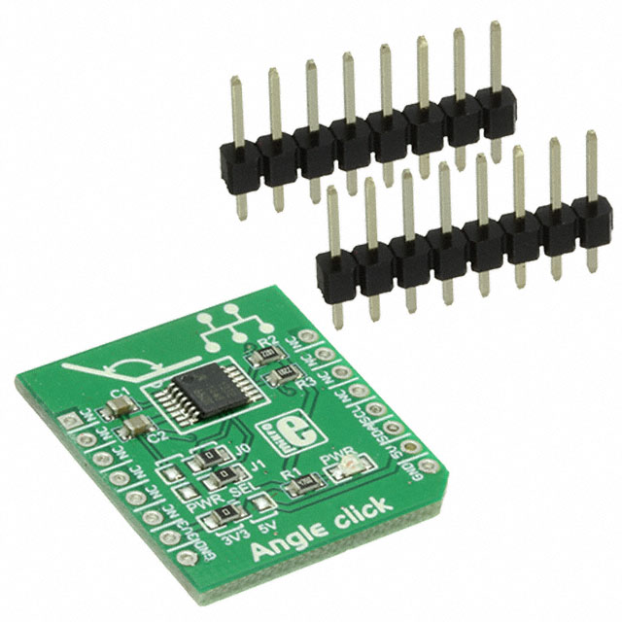
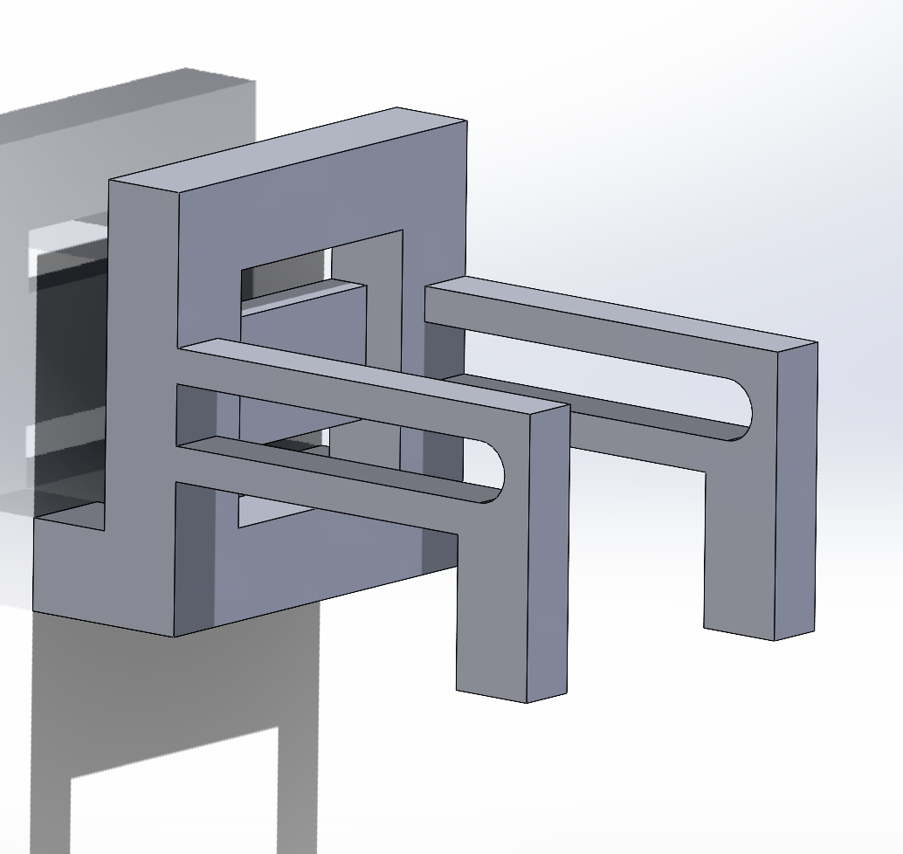
Hall effect sensor testing apparatus
Found expansion circuit board that will connect the A1335 rotary hall effect sensor to the Raspberry Pi
Next step - Modify and print the test rig according to the new board specifications

Slide 8
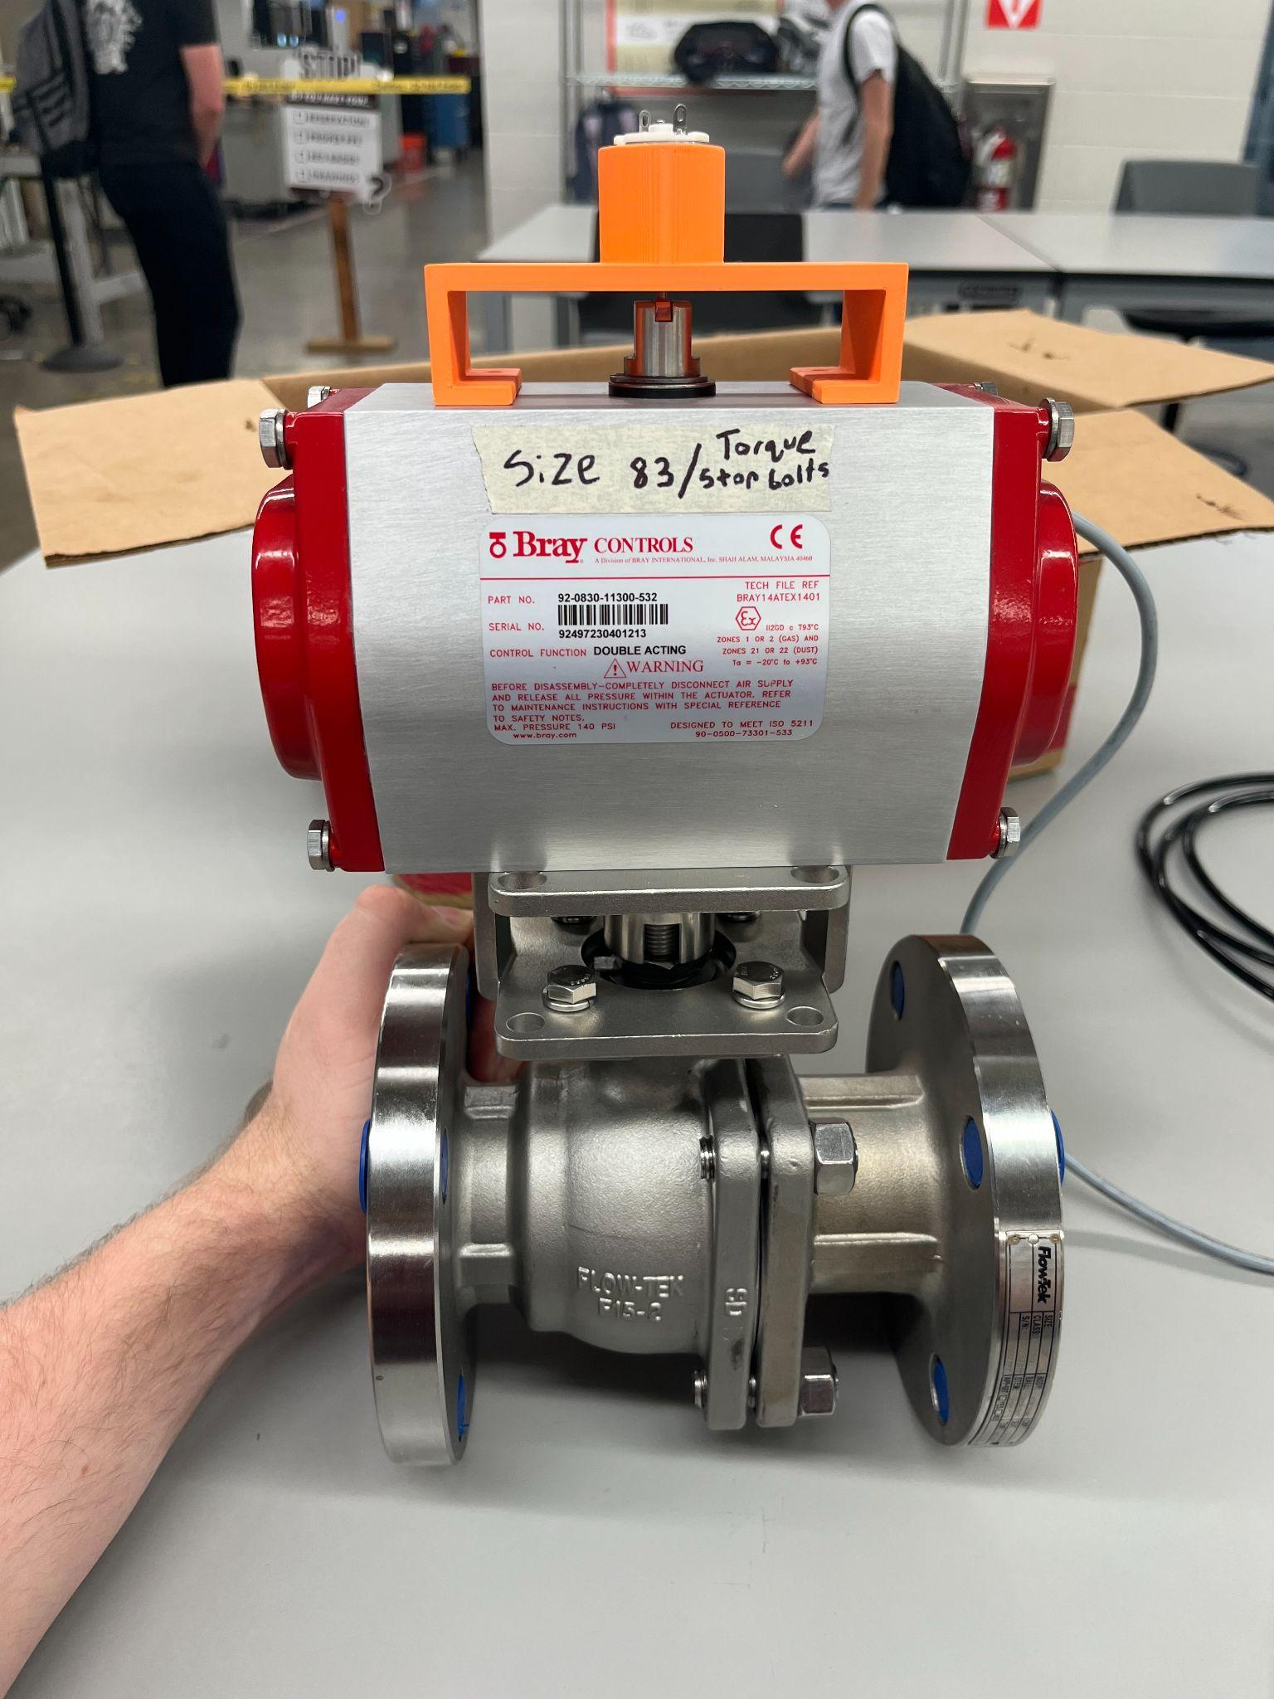
Motor Bracket
Motor mounted to actuator and ball valve system
Machined connecting slit to attached to the stem
Soldered wires for motor to connect to the Pi.

Slide 9
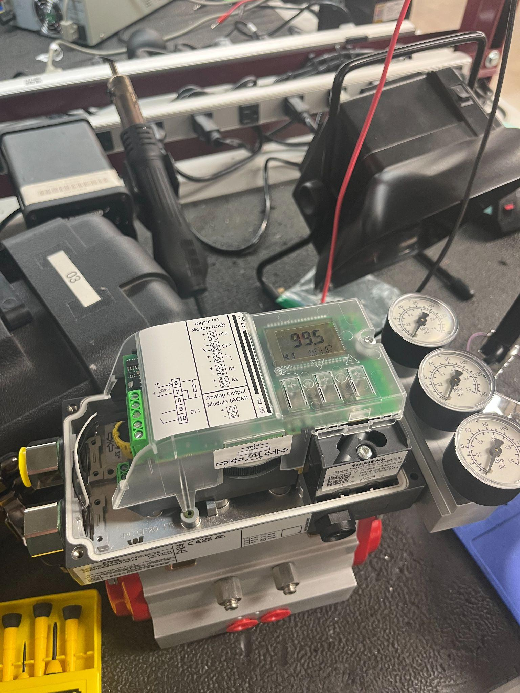
Positioner
Able to power with a DC power supply set to 4-20mA
Completed to last stage of calibration. Need to hook up to shop air in order to complete calibration
Learned how to navigate the menu and different settings

Slide 10
Remaining Validation
Receive and print 2nd iteration of hall effect test rig.
Begin testing with potentiometer in the valve.
Start measuring time and voltage to see if a correct estimate of torque can be made.
Inquire with the FEDC on the proper environment to use the adhesives in and equipment that is needed.

Slide 11
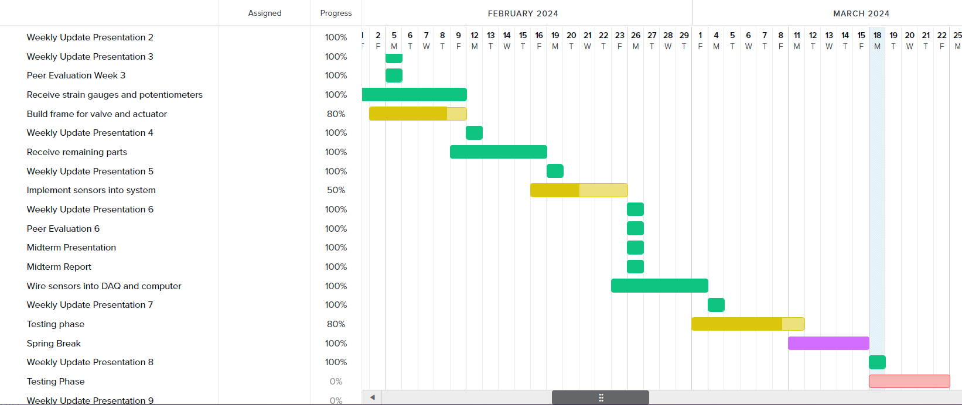
Gantt Chart

Slide 12
Next Week's Deliverables
Tasks | Lead | Percentage Done | Notes
Begin potentiometer validation testing | Avery/Locke | 50% | Ready for testing.
Test motor system | Cody/Travis | 50% | Motor mounted into the stem of the actuator. And wired to the Pi
Implement strain gauges into stop bolts | Zack | 25% | Talk with FEDC about PPE and space.
Prep Hall effect sensor Test | Locke/Travis | 25% | Made design, received sensor, must print test rig using new circuit board.

